Slide 1
Guitar Copilot

Slide 2
Pain point
Guitarist
Lack a all-in-1 tool to learn and play guitar
Lack a fastest (ads free) guitar tuner, metronome, tabs(chord)
Lack a guitar reels platform to watch just guitar-related reel shorts
Lack a self guitar notes / tab jotting board (notion-like but for guitar)

Slide 3
Goal
- The all-in-one practical use of guitarist

Slide 4
Feature - Rhythm Suggestion
Rhythm
Arpeggio (Broken chord fingering)
- Strumming

Slide 5
4/4

Slide 6
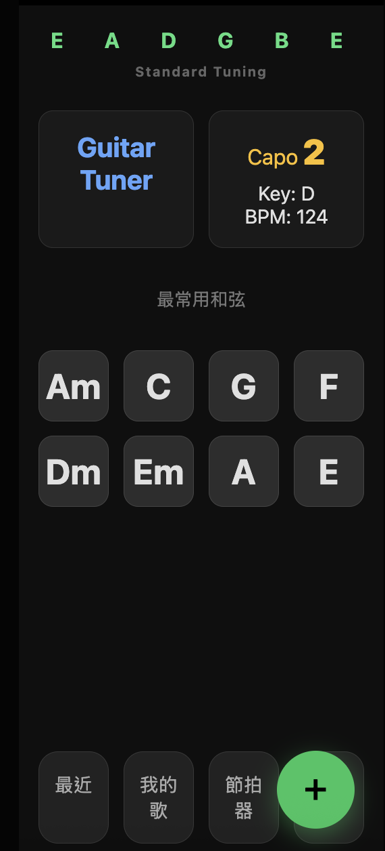
UI / UX Design

